Slide 1

2021 AP® Exams Overview Guide
Preserving Opportunities for Students
Updated 2/10/21

Slide 2
Contents
1
About the 2021 AP Exams
2
AP Exam Schedule
3
Planning Your Exam Administration
4
Supports for Teaching and Learning
5
Q&A

Slide 3
About the 2021 AP® Exams
1
Cover Page

Slide 4

Overview
About the 2021 AP Exams
Guiding Principles
Key Features
Decisions for 2021 AP® Exams were made to prioritize the health and safety of educators and students while preserving opportunities for motivated students to earn college credit.
The 2021 AP Exams will cover the full course content so that students are accurately placed into higher-level courses where they can succeed when they get to college.
If it’s safe and feasible, we advocate for in-school testing because it maximizes opportunities for students, but we’re providing multiple exam dates for all AP courses and, if safety conditions require it, a backup at-home digital testing option for 25 AP courses.
Schools have a variety of testing options, with 3 administration windows, that reflect the unique characteristics of each exam and the preferences we've heard from AP teachers, coordinators, and school leaders.
Digital exams are available for 25 AP courses, and they can be administered in school or authorized for at-home testing, if in-school testing isn't possible.
Schools don’t need to pick just one of the testing windows or modes. AP coordinators can authorize a mix of at-home and in-person exams and mix testing dates, as needed.
All cancellation fees are waived to give students utmost flexibility.
Free, live review sessions can help students review course content and skills while free, on-demand resources on AP Classroom can help students practice skills before exams.

Slide 5
Mix and Match Among 3 Testing Windows
Schools can choose to offer AP Exams at a time that’s right for individual students.
MAY 2021
Sunday | Monday | Tuesday | Wednesday | Thursday | Friday | Saturday
 |  |  |  |  |  | 1
2 | 3 | 4 | 5 | 6 | 7 | 8
9 | 10 | 11 | 12 | 13 | 14 | 15
16 | 17 | 18 | 19 | 20 | 21 | 22
23 | 24 | 25 | 26 | 27 | 28 | 29
30 | 31
JUNE 2021
Sunday | Monday | Tuesday | Wednesday | Thursday | Friday | Saturday
 |  | 1 | 2 | 3 | 4 | 5
6 | 7 | 8 | 9 | 10 | 11 | 12
13 | 14 | 15 | 16 | 17 | 18 | 19
20 | 21 | 22 | 23 | 24 | 25 | 26
27 | 28 | 29 | 30
ADMIN 3
ADMIN 1
ADMIN 3
ADMIN 1
ADMIN 1
ADMIN 1
ADMIN 2
ADMIN 2

Slide 6
Mix and Match Between 2 Location Settings
Schools can choose to offer AP Exams at a place that’s right for individual students.
In School
At Home
Schools that can safely administer paper and pencil exams or digital exams in school buildings or at other school-proctored locations should do so.
Students are more likely to face fewer disruptions than when attempting to take a test at home.
To increase local flexibility and preserve credit-earning opportunities for students who aren't able to take an in-school exam this year, the school’s AP coordinator can authorize students to take backup, at-home digital testing options for 25 AP courses, if in-school testing isn't possible.

Slide 7
Overview: Exam Administration Options
Schools can choose the options that best serve their instructional schedules and safety needs.
 | IN-SCHOOL EXAMS |  | AT-HOME EXAMS
 | Traditional Paper and Pencil* | Digital* | Digital*
Administration 1 May 3–7, 10–12, 14, and 17 | ✔ 34 Exams
Administration 2 May 18–21, 24–28 | ✔ 17 Exams | ✔ 17 Exams | ✔ 17 Exams
Administration 3 June 1–4, 7–11 | ✔ 9 Exams | ✔ 25 Exams | ✔ 25 Exams
All AP Exams have at least 1 in-school paper and pencil option.
Not all courses have an at-home or digital exam option.
To ensure equitable and secure testing of full course content and skills, Chinese, French, German, Italian, Japanese, and Spanish Language and Culture; Latin; Music Theory; and Spanish Literature and Culture exams can only be administered in a proctored in-school environment. Although these exams will be available to students in Administrations 1, 2, and 3, they can only be administered in schools.
All digital testing options (except Chinese and Japanese Language) have synchronous start times at 12 p.m. EDT and 4 p.m. EDT.
*AP Chinese and AP Japanese Language and Culture Exams are administered in school on a computer-based platform, in all three administrations.

Slide 8
AP Exam | Administration 1 May 3–7, 10–12, 14, and 17 | Administration 2 May 18–21, 24–28 | Administration 3 June 1–4, 7–11
AP Art History | In-School Paper and Pencil | In-School Digital and/or At-Home Digital | In-School Digital and/or At-Home Digital
AP Biology | In-School Paper and Pencil | In-School Digital and/or At-Home Digital | In-School Digital and/or At-Home Digital
AP Calculus AB | In-School Paper and Pencil | In-School Paper and Pencil | In-School Digital and/or At-Home Digital
AP Calculus BC | In-School Paper and Pencil | In-School Paper and Pencil | In-School Digital and/or At-Home Digital
AP Chemistry | In-School Paper and Pencil | In-School Paper and Pencil | In-School Digital and/or At-Home Digital
AP Chinese Language and Culture | In-School Computer-Based* | In-School Computer-Based* | In-School Computer-Based*
AP Comparative Government and Politics | In-School Paper and Pencil | In-School Digital and/or At-Home Digital | In-School Digital and/or At-Home Digital
AP Computer Science A | In-School Paper and Pencil | In-School Digital and/or At-Home Digital | In-School Digital and/or At-Home Digital
AP Computer Science Principles | In-School Paper and Pencil | In-School Digital and/or At-Home Digital | In-School Digital and/or At-Home Digital
AP English Language and Composition | In-School Paper and Pencil | In-School Digital and/or At-Home Digital | In-School Digital and/or At-Home Digital
AP English Literature and Composition | In-School Paper and Pencil | In-School Digital and/or At-Home Digital | In-School Digital and/or At-Home Digital
AP Environmental Science | In-School Paper and Pencil | In-School Digital and/or At-Home Digital | In-School Digital and/or At-Home Digital
AP European History | In-School Paper and Pencil | In-School Digital and/or At-Home Digital | In-School Digital and/or At-Home Digital
AP French Language and Culture | In-School Paper and Pencil | In-School Paper and Pencil | In-School Paper and Pencil
AP German Language and Culture | In-School Paper and Pencil | In-School Paper and Pencil | In-School Paper and Pencil
AP Human Geography | In-School Paper and Pencil | In-School Digital and/or At-Home Digital | In-School Digital and/or At-Home Digital
AP Italian Language and Culture | In-School Paper and Pencil | In-School Paper and Pencil | In-School Paper and Pencil
AP Japanese Language and Culture | In-School Computer-Based* | In-School Computer-Based* | In-School Computer-Based*
AP Latin | In-School Paper and Pencil | In-School Paper and Pencil | In-School Paper and Pencil
AP Macroeconomics | In-School Paper and Pencil | In-School Digital and/or At-Home Digital | In-School Digital and/or At-Home Digital
AP Microeconomics | In-School Paper and Pencil | In-School Digital and/or At-Home Digital | In-School Digital and/or At-Home Digital
AP Music Theory | In-School Paper and Pencil | In-School Paper and Pencil | In-School Paper and Pencil
AP Physics 1: Algebra-Based | In-School Paper and Pencil | In-School Paper and Pencil | In-School Digital and/or At-Home Digital
AP Physics 2: Algebra-Based | In-School Paper and Pencil | In-School Paper and Pencil | In-School Digital and/or At-Home Digital
AP Physics C: Electricity and Magnetism | In-School Paper and Pencil | In-School Paper and Pencil | In-School Digital and/or At-Home Digital
AP Physics C: Mechanics | In-School Paper and Pencil | In-School Paper and Pencil | In-School Digital and/or At-Home Digital
AP Psychology | In-School Paper and Pencil | In-School Digital and/or At-Home Digital | In-School Digital and/or At-Home Digital
AP Seminar | In-School Paper and Pencil | In-School Digital and/or At-Home Digital | In-School Digital and/or At-Home Digital
AP Spanish Language and Culture | In-School Paper and Pencil | In-School Paper and Pencil | In-School Paper and Pencil
AP Spanish Literature and Culture | In-School Paper and Pencil | In-School Paper and Pencil | In-School Paper and Pencil
AP Statistics | In-School Paper and Pencil | In-School Paper and Pencil | In-School Digital and/or At-Home Digital
AP United States Government and Politics | In-School Paper and Pencil | In-School Digital and/or At-Home Digital | In-School Digital and/or At-Home Digital
AP United States History | In-School Paper and Pencil | In-School Digital and/or At-Home Digital | In-School Digital and/or At-Home Digital
AP World History: Modern | In-School Paper and Pencil | In-School Digital and/or At-Home Digital | In-School Digital and/or At-Home Digital
*AP Chinese and AP Japanese are administered in-school on a computer-based platform, in all three administrations.

Slide 9
Summary: Exam Administration Options
Schools can mix and match among these testing options.
Administration 1
(Paper and Pencil Only)
May 3–7, 10–12, 14, and 17
Traditional, full-length paper and pencil exams, administered in school, for all subjects.
AP Chinese and AP Japanese Language and Culture will remain in-school, computer-based assessments, as in the past.
Administration 2
(Half Paper and Pencil / Half Digital)
May 18–21, 24–28
Half of the subjects are full-length paper and pencil, administered in school, and half are full-length digital exams, administered in school or taken at home due to coronavirus precautions.
Can be used if a school lost significant instructional time due to a delayed school start.
Make up for conflicts or disruptions during Administration 1.
Can be used if testing isn't possible for some or all subjects during Administration 1.
Administration 3
(Some Paper and Pencil / Most Digital)
June 1–4, 7–11
Most subjects are full-length digital exams only, administered in school or taken at home due to coronavirus precautions.
Can be used if a school lost significant instructional time.
Make up for conflicts or disruptions during Administration 1 or Administration 2.
Can be used if testing isn't possible for some or all subjects during Administration 1 or Administration 2.
Digital Portfolios
Submission Deadline:
May 20 11:59 p.m. EDT
Extended deadline for AP Art and Design portfolios and AP Computer Science Principles, AP Seminar, and AP Research performance tasks.
Schools don't need to pick just one of the testing windows.
Not all courses have an at-home digital exam option due to fairness and security concerns.
An additional digital exam makeup date will be provided after Administration 3 for all subjects that have digital exams.
Details

Slide 10
Mix and Match Testing Options: Courses
Scenario A
When deciding when and where students will test, a school can make different decisions for different courses, sections, and/or students, as needs and circumstances require.
Issue:
To comply with social distancing protocols, School A has repurposed the gym for the AP Exam administrations and will be assigning specific arrival times to students.
50 students are planning to take the in-school paper and pencil AP English Language and Composition Exam. 75 students are planning to take the in-school paper and pencil AP Microeconomics Exam.
School A is concerned that it won’t be able to start the AP Microeconomics Exam on time, which is scheduled to begin immediately following the AP English Language and Composition Exam.
All desks in the gym must be disinfected after the first exam before additional students can begin arriving in the gym to take the second exam.
The school won’t be able to coordinate a socially distanced departure from the first exam, disinfect the gym, and socially distance the arrival of students before the second exam is scheduled to begin—even with the 1-hour start-time window.
Solution:
In order to provide maximum flexibility and ensure they're adhering to health and safety protocols, School A decided to schedule AP Microeconomics Exam for Administration 2, as an in-school digital exam.

Slide 11
Mix and Match Testing Options: Sections
Scenario B
When deciding when and where students will test, a school can make different decisions for different courses, sections, and students, as needs and circumstances require.
Issue:
School B has opted to schedule the AP Psychology Exam as in-school digital during Administration 2—to make up for lost instructional time.
There are 2 sections of the AP course: 25 students in Period 5 and 25 students in Period 6.
Recently adopted “large gathering” protocols for the school require standardized testing to be held in spaces large enough to allow for sufficient social distancing.
Normally, School B would test the students across multiple classrooms, but this year they’ve had to spread out classrooms into the gymnasium and cafeteria to comply with the health and safety protocols.
Solution:
To ensure all students have the opportunity to test in school while also adhering to coronavirus protocols, School B decided to schedule all students from Period 5 during Administration 2 and all students from Period 6 during Administration 3.

Slide 12
Mix and Match Testing Options: Students
Scenario C
When deciding when and where students will test, a school can make different decisions for different courses, sections, and students, as needs and circumstances require.
Issue:
School C has 100 students planning to take the AP United States History Exam during Administration 2—to help make up for lost instructional time.
The school is facing a challenge because, while they'll be opening the school building for in-school digital testing, they have 10 students who are considered "high risk" due to underlying health conditions.
Solution:
For health and safety reasons, the AP coordinator authorized at-home digital exams for the 10 students who are unable to test in school and scheduled the other 90 students for in-school digital exams.

Slide 13
Additional Details
About the 2021 AP Exams
Exam Fees
This year, AP will waive the $40 cancellation or unused exam fee, so all students have the flexibility this year demands.
See Exam Fees for the latest on AP Exam fees, refunds, and payment.
Learn about AP Exam Fee Reductions and AP Exam Fee Assistance.
Exam Registration
The AP Exam Spring Course Orders and Fall Order Changes deadline remains March 12, 11:59 p.m. ET.
Starting in March, AP coordinators can use AP Registration and Ordering to update the testing date and location for each AP student, if needed.
Learn about Managing Exam Order.
Scores
As usual, students’ work will be scored by college faculty and AP teachers, and will be reported on a 1–5 scale.
Scores are anticipated to be released in July for Administration 1 and Administration 2 and in August for Administration 3.
Instructional Planning Reports will be available only for exams taken during Administration 1.

Slide 14
AP Exam Schedule
2
Cover Page

Slide 15
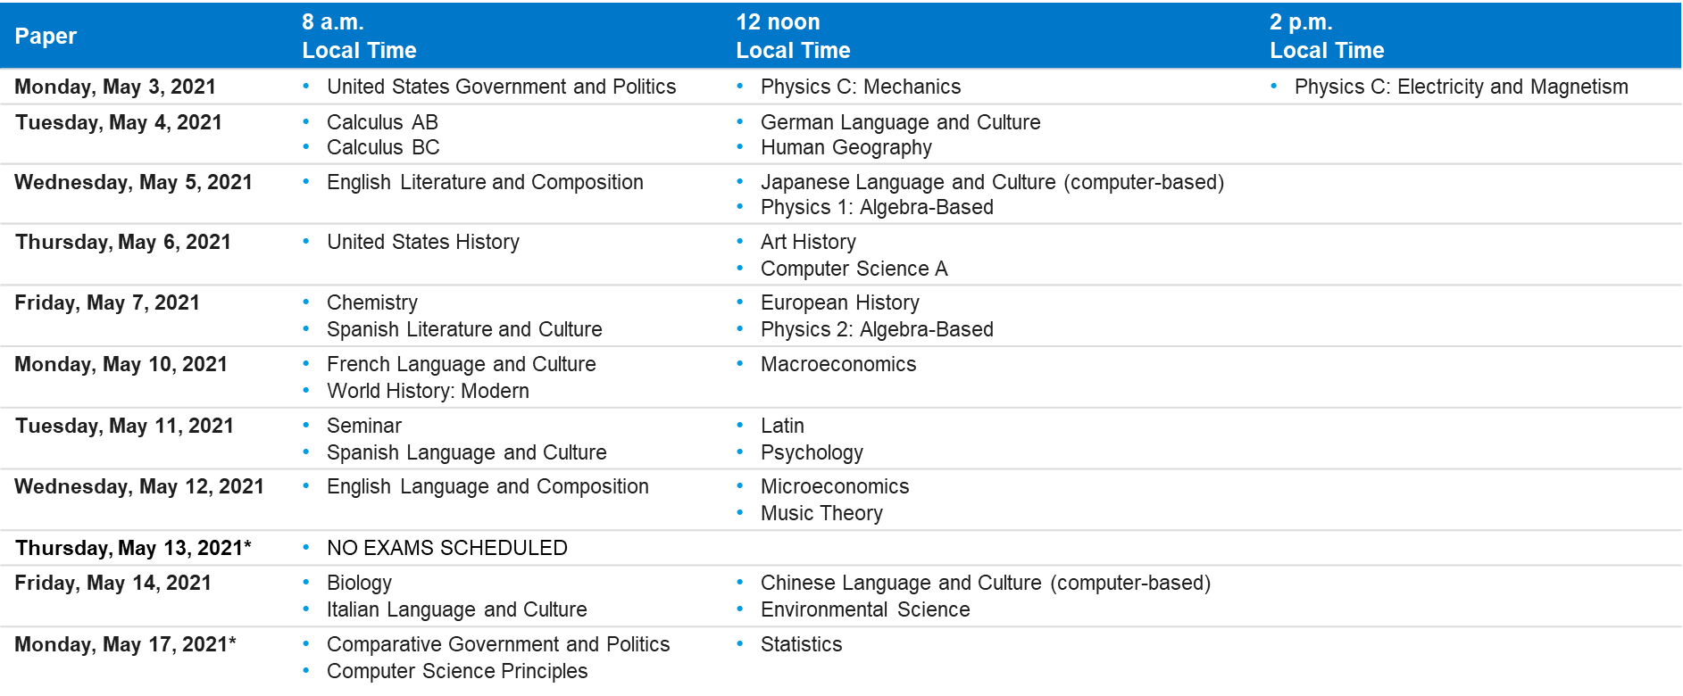
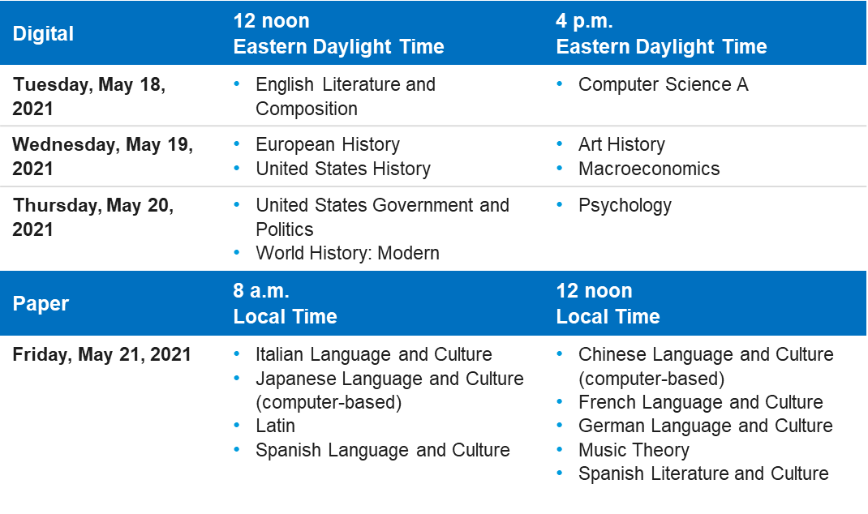
Reading the AP Exam Schedule
AP Exam Schedule
Each administration calendar designates AP Exam administration dates, the start time of each exam, and whether an exam is paper and pencil or digital.
The exam format, whether paper and pencil or digital, is indicated in the blue header above the exam dates.
In-school paper and pencil exams are scheduled to start at 8 a.m., 12 noon, and 2 p.m. local time.
Digital exams, whether they’re taken in school or at home, are scheduled for simultaneous start times worldwide at 12 p.m. and 4 p.m. EDT.
During Administration 1, no exams are scheduled for Thursday, May 13, to avoid conflicts for students observing Eid al-Fitr. Exams previously scheduled for May 13 will instead be administered on May 17.

Slide 16
Administration 1
2021 AP Exam Schedule
Paper | 8 a.m. Local Time | 12 noon Local Time | 2 p.m. Local Time
Monday, May 3, 2021 | United States Government and Politics | Physics C: Mechanics | Physics C: Electricity and Magnetism
Tuesday, May 4, 2021 | Calculus AB Calculus BC | German Language and Culture Human Geography
Wednesday, May 5, 2021 | English Literature and Composition | Japanese Language and Culture (computer-based) Physics 1: Algebra-Based
Thursday, May 6, 2021 | United States History | Art History Computer Science A
Friday, May 7, 2021 | Chemistry Spanish Literature and Culture | European History Physics 2: Algebra-Based
Monday, May 10, 2021 | French Language and Culture World History: Modern | Macroeconomics
Tuesday, May 11, 2021 | Seminar Spanish Language and Culture | Latin Psychology
Wednesday, May 12, 2021 | English Language and Composition | Microeconomics Music Theory
Thursday, May 13, 2021* | NO EXAMS SCHEDULED
Friday, May 14, 2021 | Biology Italian Language and Culture | Chinese Language and Culture (computer-based) Environmental Science
Monday, May 17, 2021* | Comparative Government and Politics Computer Science Principles | Statistics

Slide 17
Administration 2
2021 AP Exam Schedule
Digital | 12 noon Eastern Daylight Time | 4 p.m. Eastern Daylight Time
Tuesday, May 18, 2021 | English Literature and Composition | Computer Science A
Wednesday, May 19, 2021 | European History United States History | Art History Macroeconomics
Thursday, May 20, 2021 | United States Government and Politics World History: Modern | Psychology
Paper | 8 a.m. Local Time | 12 noon Local Time
Friday, May 21, 2021 | Italian Language and Culture Japanese Language and Culture (computer-based) Latin Spanish Language and Culture | Chinese Language and Culture (computer-based) French Language and Culture German Language and Culture Music Theory Spanish Literature and Culture
Paper | 8 a.m. Local Time | 12 noon Local Time
Monday, May 24, 2021 | Calculus AB Calculus BC | Physics 1: Algebra-Based Physics C: Mechanics
Tuesday, May 25, 2021 | Chemistry Physics C: Electricity and Magnetism | Physics 2: Algebra-Based Statistics
Digital | 12 noon Eastern Daylight Time | 4 p.m. Eastern Daylight Time
Wednesday, May 26, 2021 | English Language and Composition | Computer Science Principles Seminar
Thursday, May 27, 2021 | Biology | Environmental Science
Friday, May 28, 2021 | Comparative Government and Politics Human Geography | Microeconomics

Slide 18
Administration 3
2021 AP Exam Schedule
Digital | 12 noon Eastern Daylight Time | 4 p.m. Eastern Daylight Time
Tuesday, June 1, 2021 | English Literature and Composition | Computer Science A
Wednesday, June 2, 2021 | European History United States History | Art History Macroeconomics
Thursday, June 3, 2021 | United States Government and Politics World History: Modern | Psychology
Paper | 8 a.m. Local Time | 12 noon Local Time
Friday, June 4, 2021 | Italian Language and Culture Japanese Language and Culture (computer-based) Latin Spanish Language and Culture | Chinese Language and Culture (computer-based) French Language and Culture German Language and Culture Music Theory Spanish Literature and Culture
Digital | 12 noon Eastern Daylight Time | 4 p.m. Eastern Daylight Time
Monday, June 7, 2021 | English Language and Composition | Computer Science Principles Seminar
Tuesday, June 8, 2021 | Comparative Government and Politics Human Geography | Microeconomics
Wednesday, June 9, 2021 | Calculus AB Calculus BC | Physics 1: Algebra-Based Physics C: Mechanics
Thursday, June 10, 2021 | Chemistry Physics C: Electricity and Magnetism | Statistics Physics 2: Algebra-Based
Friday, June 11, 2021 | Biology | Environmental Science

Slide 19
Digital Portfolio Submission Deadlines
2021 AP Exam Schedule
Thursday, May 20, 2021
11:59 PM EDT
AP Art and Design Digital Portfolios | apstudio.ets.org/apstudioart
AP Seminar Performance Tasks | digitalportfolio.collegeboard.org
AP Research Performance Tasks | digitalportfolio.collegeboard.org
AP Computer Science Principles Performance Tasks | digitalportfolio.collegeboard.org

Slide 20
Planning Your Exam Administration
3
Cover Page

Slide 21
How It Works
Planning Your Exam Administration
Use Flexible Testing Windows. Schools can choose the exam administration options that work best for them—paper and pencil exams administered in school, digital exams administered in school, digital exams taken at home, or a mix—provided the school meets all requirements for each option.
Authorize Digital Exams in APRO. Throughout the spring and during the testing windows, AP coordinators will be able to use AP Registration and Ordering to reassign students to later testing dates if any changes of plan occur.
Plan for Makeup Digital Exams. Even if a school is only planning to administer paper and pencil exams, it should ensure that its students are prepared to take the digital version of the exam (if applicable), in the event they need to take a makeup digital exam.
Mix and Match as Needed. When deciding when and where students will test, a school can make different decisions for different courses, different sections, and different students, as needs and circumstances require. For example:
To have more space for social distancing while testing, a school could spread its AP testing across all 3 administration windows: utilizing the Administration 1 paper and pencil exams for some subjects, the Administration 2 digital exams in school for other subjects, and the Administration 3 digital exams in school for other subjects.
A school could administer the Administration 2 digital exams in school for most students, while also authorizing at-home testing for any students who have coronavirus-related reasons not to test in person.

Slide 22
Help Safeguard Students Testing in School
Planning Your Exam Administration
Continue to follow local health and safety guidelines to help keep your students safe. Here are some updates and reminders to help you with your safe administration of AP Exams, whether you're administering paper and pencil or digital exams:
NEW Off-site testing: If schools need more space to test students, they may test some or all students at off-site locations, such as libraries, colleges/universities, and convention centers. This year, our off-site testing policy allows schools to divide an exam subject across multiple locations, if necessary. All proctoring and other off-site testing requirements apply.
NEW Clear partitions: Typically, the use of partitions is prohibited. However, this year, clear partitions may be used as a safety measure if desired. The partitions must not prevent the proctor from seeing students.
Proctors: Schools may need more exam rooms and/or locations due to social distancing. Schools must maintain the required proctor-to-student ratio, and all proctors must meet AP proctor eligibility requirements.
Seating: To adhere to state or district requirements, schools may seat students further apart than they usually do for AP Exams. Minimum seating distance requirements for AP Exams to maintain exam security—5 feet for most exams, 4 feet for U.S. History and Calculus exams—still apply, along with all other seating policies, including having all students face the same direction.
Start times for paper and pencil exams: Schools can begin paper and pencil exams and Chinese and Japanese exams up to 1 hour after the official start time (local time), giving them flexibility to manage arrival times of students to provide greatest social distancing.
NEW Start times for digital exams: Digital exams are administered at the same time worldwide because some students will be required to test from home due to coronavirus, so there's no flexibility in the start time for digital exams. All students must be present and begin the check-in process 30 minutes before the official start time, when the first exam question will appear and the timer will begin. All students taking digital exams must also be seated by the conclusion of the built-in break—the exam will resume automatically at the same time for all students taking a particular exam.

Slide 23
Digital Exams: An Overview
Planning Your Exam Administration
Whether digital exams are given in school or taken at home, schools are responsible for ensuring that all requirements for digital testing are met and that students complete all setup and readiness steps before exam day and abide by exam security policies while testing.
The following details apply to all digital exams, whether administered in school or at home, except for Chinese and Japanese exams.
Format | Start Times | Authorization
Digital exams will be full length and test the same knowledge and skills as paper and pencil exams, in a format-appropriate manner. Students will answer free-response questions with a keyboard, rather than by hand. The digital exam app will include any symbols students would need to type their responses. No handwritten or photographed work will be required or accepted. | Full-length digital AP Exams, whether taken in school or at home, have simultaneous start times worldwide in Administration 2 and Administration 3. | If needed, the school’s AP coordinator can authorize students to take these exams securely at home without requesting approval from College Board, as a testing option for schools that are closed or have students who are unable to test in school for safety reasons.
Exam Application | Devices | Makeup Exams
Students will need to install the AP Exam application on the computer they'll use throughout AP testing this year; this WILL NOT be the same digital testing platform that was used for emergency testing in spring 2020. Students will not need to install the LockDown Browser they may use for secure AP Classroom assignments. | Because the full-length digital AP Exams require typewritten responses in the free-response section, the exams can’t be taken on smartphones. Digital exams taken on desktop or laptop computers (Windows, Mac, school-managed Chromebook) will be the sole exam format for many subjects on the Administration 2 and Administration 3 test dates. | Even if a school is only planning to administer paper and pencil exams, it should ensure that its students are prepared to take the digital version of the exam (if applicable), in the event they need to take a makeup exam that is only offered digitally.

Slide 24
Digital Exams: Implementation Details
Planning Your Exam Administration
The following details apply to all digital exams, whether administered in school or at home, except for Chinese and Japanese exams.
Exam Security | Accommodations | Exam Practice
2021 AP digital exams have been designed with security in mind, so students can take exams at home if they're unable to test at their school. Digital exams administered in school or at home will: Not allow students to return to answered questions or move back and forth between unanswered questions. Begin at the same time worldwide with synchronous section start times. Not include questions that can be answered with internet searches, textbooks, notes, study guides, or similar material. Include security features to prevent students from collaborating, accessing unauthorized aids, or attempting to have someone else test for them. Be reviewed with plagiarism detection software and other monitors and post-exam analyses for detecting exam violations. Exam violations on any AP Exam—paper and pencil or digital—will result in a score cancellation and additional consequences as warranted. | Digital exams will be accessible to students with disabilities who are approved for testing accommodations. Detailed information about accommodations for digital exams will be available in early March. | Beginning in April, students and educators can download the exam application and access a digital exam practice resource that enables students to confirm the viability of their technology well before test day, experience the exam day flow, and practice answering exam questions, including each type of multiple-choice and free-response question they’ll encounter on exam day.
 | Readiness Dashboard | Sign In
 | In April, educators will have access to a dashboard that helps them track their students’ progress in preparing for and completing digital exams. | Students will need to use their College Board username/password to access digital exams.

Slide 25
Digital Exams: Testing Requirements
Planning Your Exam Administration
 | Digital Testing in School (or at a school-selected location) | Digital Testing at Home (if authorized by the AP coordinator)
Computer | Each student will need access to a laptop computer (Mac, Windows, or school-managed Chromebook). The computer can be a personal computer or a school-provided computer but must not be shared between students after exam setup is completed. | Each student will need access to a desktop or laptop computer (Mac, Windows, or school-managed Chromebook). The computer can be a personal computer or a school-provided computer but must not be shared between students after exam setup is completed.
Power | While students will be asked to have a fully charged computer to last through the full-length exams, schools will need to ensure that a student can access an electrical outlet, if needed. | Students’ computers must be fully charged to last through the full-length exams and be able to be plugged in during the exam, if needed.
Internet/ Network access | Students must be able to access a reliable internet connection that can support concurrent data transmission commensurate with the volume of students taking the exam in the same location. Students will need to be able to access their school’s internet network, and the network must allow outbound traffic to College Board and inbound traffic from College Board. | Students must have a reliable internet connection. Our testing application has been designed to be tolerant of disruptions in internet connectivity during the exam.

Slide 26
Digital Exams: Testing Requirements
Planning Your Exam Administration
 | Digital Testing in School (or at a school-selected location) | Digital Testing at Home (if authorized by the AP coordinator)
Readiness steps | Schools must ensure that all students complete all required readiness steps before exam day. Students will need to be able to install the testing application on their computer. If students are using school- or district-managed devices, the application will need to be pushed down centrally or permission for downloading the application will need to be granted. Students will need to complete exam setup ahead of each exam day on the specific computer that they plan to use for testing. Exam setup will be available 3 days before exam day and must be completed no later than the day before exam day.
Start times | Schools need to be able to support the start of testing at exactly 12 p.m. eastern daylight time and 4 p.m. eastern daylight time and provide students with a proctored testing environment for the duration of the exam(s). All digital testing, whether at home and in school, will start at the exact same time, worldwide. Please note that students will need to be seated in the testing room and check in online 30 minutes before the official start time. | Students must understand that testing starts at exactly 12 p.m. eastern daylight time and 4 p.m. eastern daylight time. Digital exams for a specific subject start at the exact same time, worldwide. Please note that students will need to check in online 30 minutes before the official start time.

Slide 27
Stay Tuned for More Information
Planning Your Exam Administration
On March 2, we’ll provide additional details, including the AP Digital Testing Guide. Here’s what to expect:
Step-by-step instructions AP coordinators will use to assign each student to a test date
Technical requirements for digital testing
Information about how students will access digital exams
Information about digital exam accommodations for students with disabilities
Digital exam readiness procedures and practice options
Proctoring instructions for digital exams administered in schools
Initial information about how and when to push the AP Exam application out to school-managed devices. More information on this topic will follow in early April.

Slide 28
Additional Resources
Planning Your Exam Administration
2021 AP Exam Schedule with dates and times, by course, for 2021 AP Exams | cb.org/apexamdates
AP Exam Administration Planning Guide for AP coordinators and administrators to use when considering planning in-school and/or at-home AP testing. | cb.org/ap2021planningguide
2021 AP Exam Administration Timeline to keep track of key 2021 exam dates and deadlines to plan ahead and see when additional testing information will be available | cb.org/ap2021timeline
AP Exam Format Information to identify course-specific details for 2021 AP Exams. | cb.org/ap2021examformat
Frequently Asked Questions to get answers to the most asked questions about 2021 AP Exams. | cb.org/ap2021faqs

Slide 29
Supports for AP Coordinators
Planning Your Exam Administration
Website: cb.org/ap2021
• Planning Updates to Your Exam Order
Downloads: collegeboard.org/apdownloads
• AP Coordinator's Manual – Part 1
• AP Coordinator's Manual – Part 2 (coming mid-February)
• Guides for setup, enrollment, and ordering
• AP Exam Format Information
Trainings: collegeboard.org/apcoordinatortraining
• Online workshops
• Audio interview series: “Coordinated”
Discussion Groups: apcommunity.collegeboard.org
• Online community for coordinators to ask questions, get answers, and connect with fellow coordinators.

Slide 30
Supports for Teaching and Learning
4
Cover Page

Slide 31
Free Resources for Teachers and Students
collegeboard.org/apclassroom
AP Instructional Resources Built for Any Learning Environment
Free, digital resources in AP Classroom provide students with daily instruction, practice, and feedback on every topic and skill covered on AP Exams. Teachers and students can also use feedback reports and the progress dashboard to focus practice before exams.
AP Daily Videos in AP Classroom
Short, searchable AP Daily videos help students learn skills and content in every course, and can be assigned by teachers in addition to topic questions, progress checks, and practice exams in AP Classroom.
AP Course Pacing Guides
New course pacing guides, designed for classrooms that have completed around 25% of typical course content by January, provide one option for teachers to use the resources in AP Classroom to catch up and expose students to all skills and content for their course.
AP Daily: Live Review
April 19–29, AP students can tune in to their AP YouTube channel for free, live review sessions for their course.

Slide 32

Additional Supports for Teachers
apcentral.collegeboard.org
Webinars and Online Sessions
collegeboard.org/apwebinars
Live and on-demand webinars and online training videos on YouTube can help teachers make the most of AP resources.
AP Teacher Community
collegeboard.org/apcommunity
By joining the AP Teacher Community for their course, teachers can connect with each other to ask questions, share support, and seek resources.
AP Classroom User Guides
collegeboard.org/apclassroom
Explore searchable user guides for how to use AP Classroom.
Teacher Guide
Student Guide
Administrator Guide

Slide 33

Additional Supports for Students
apstudents.collegeboard.org
Tech and Connectivity
Explore how College Board partners can help connect students to devices and internet access.
BigFuture™ Days
Help high school students sign up for virtual events to connect directly with college admissions representatives and take action on the most important steps for college.
College Board Opportunity Scholarships
Send students to collegeboard.org/opportunity to find out more about College Board Opportunity Scholarships.
Wyatt, Financial Assistance Chatbot
Connect seniors with Wyatt℠, a FAFSA® assistance chatbot, at getfafsahelp.org, so they can complete important steps in their college planning journey.

Slide 34
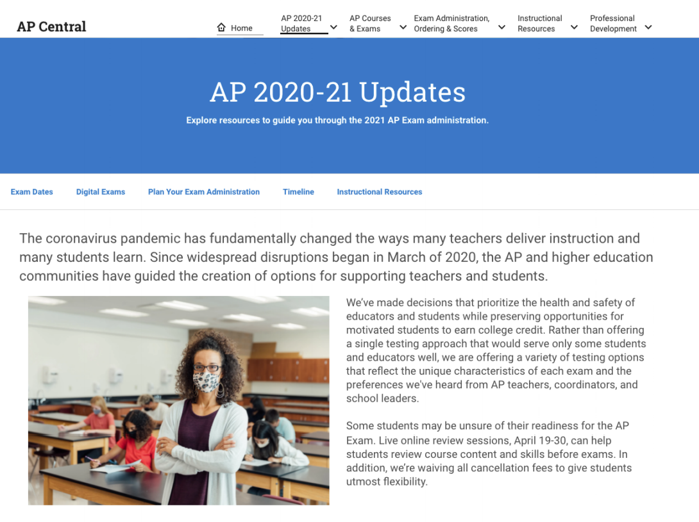
Visit AP Central® for more information
Visit AP Central® for more information
We’ll be updating the website with additional details as we have them.
For more information about 2021 AP Exams, please visit cb.org/ap2021

Slide 35
Q&A
5
Cover Page

Slide 36
Thank you.

