Slide 1
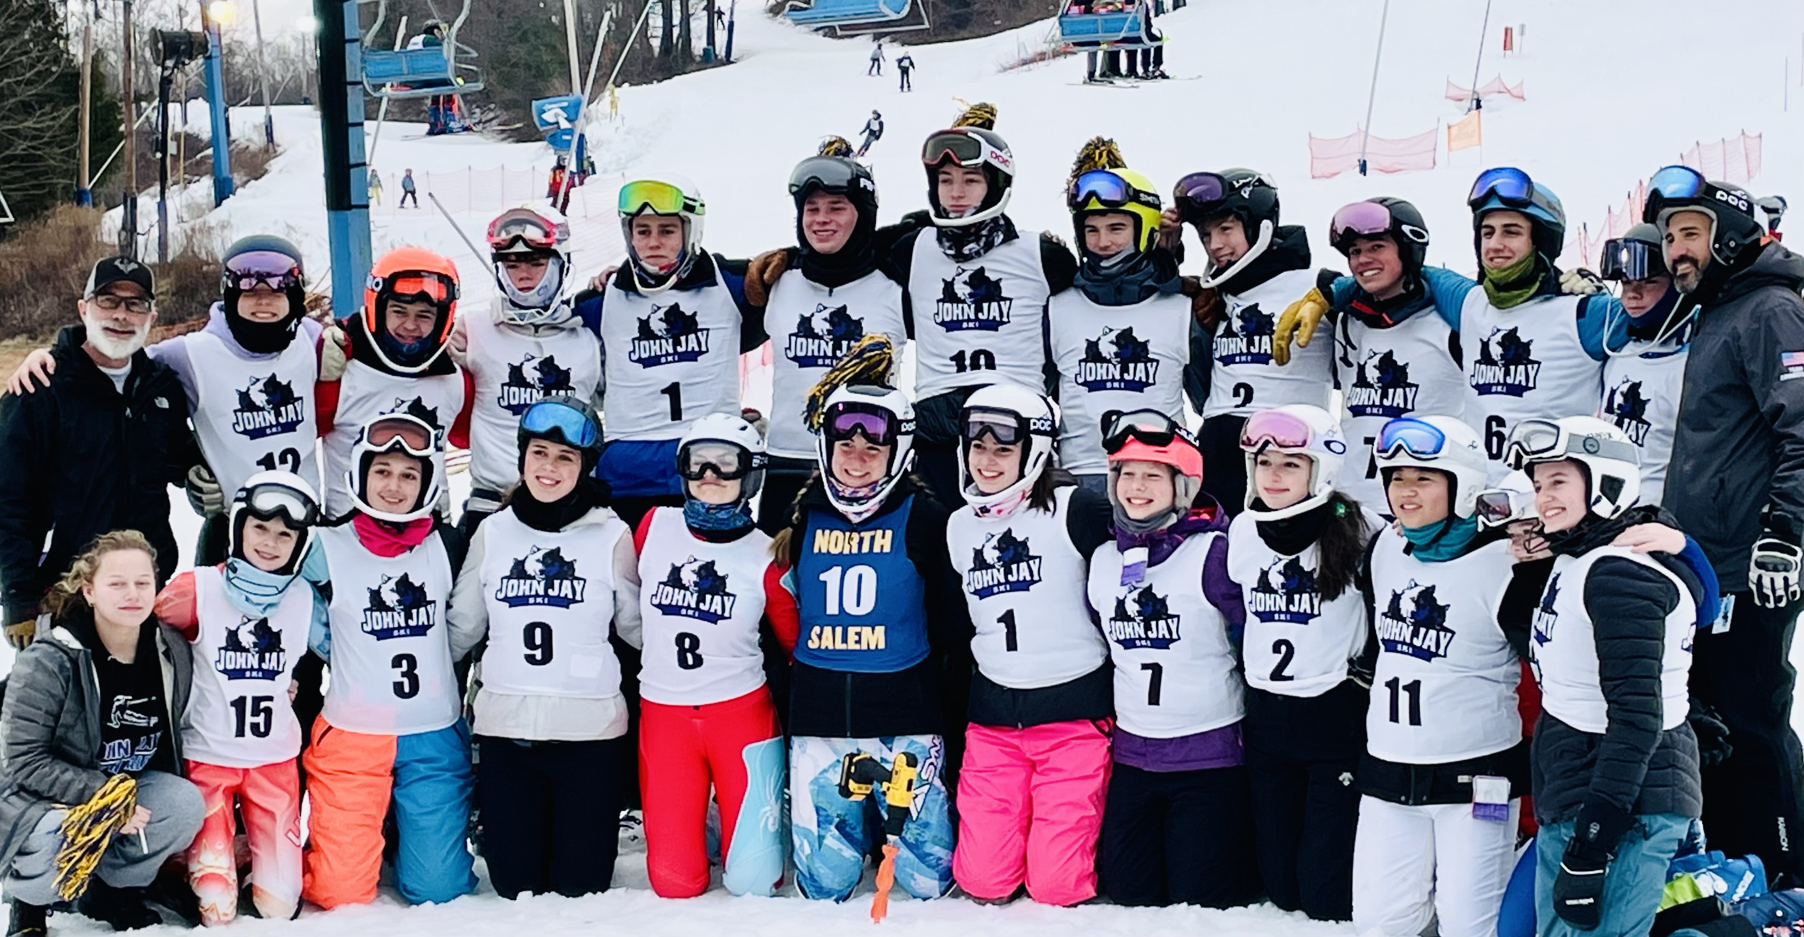
2023/2024 Alpine Race Team
WELCOME!

Slide 2
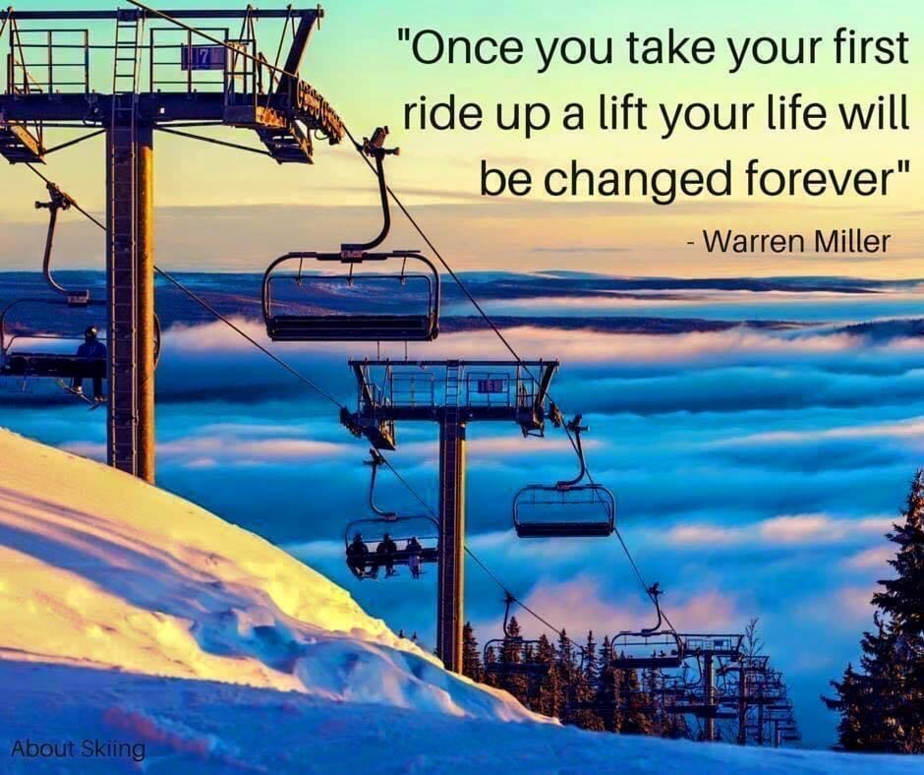

Slide 3
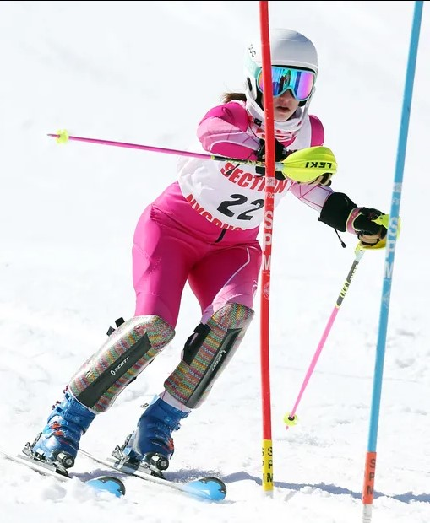
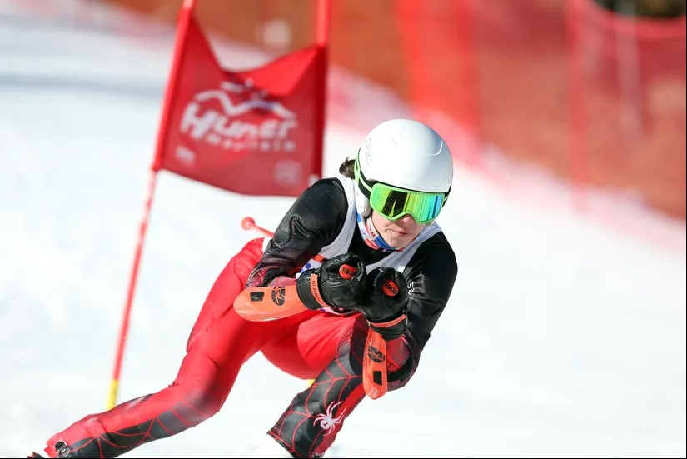
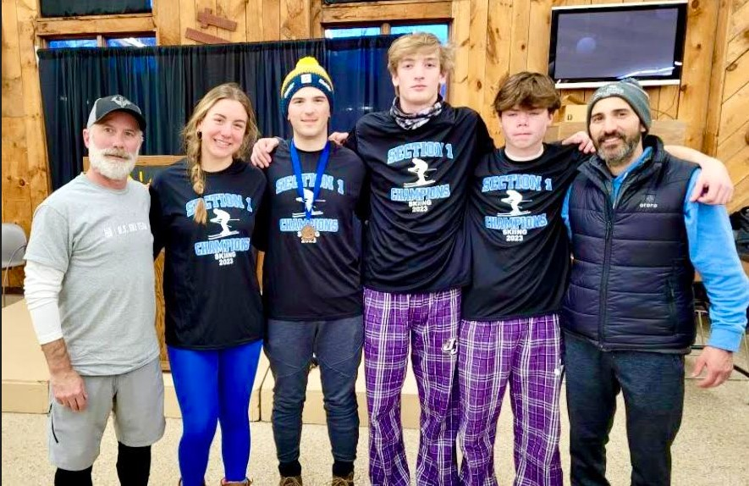
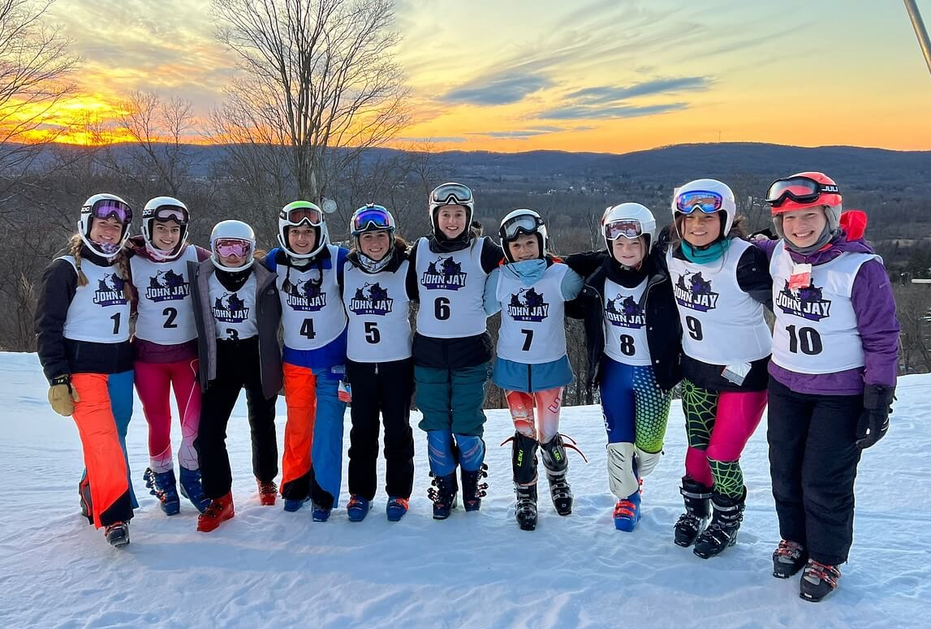
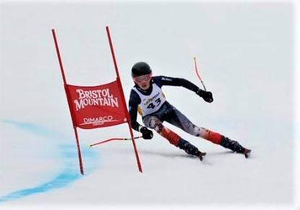
2013/2014
2016/2017
2018/2019
2014/2015
All League Champions
NYS Championships - Qualified 7
All State Champion – 1
Section 1 Champions
NYS Championships - Qualified 6
- Boys placed 3rd (Bronze)
2015/2016
2017/2018
Girls Section 1 Champions
Girls All League Champions
NYS Championships - Qualified 4
- Girls placed 4th
All League Champions
Section 1 Champions
NYS Championships - Qualified 6
Eastern Regional USSA Championships - Qualified 1
All League Champions
Section 1 Champions
NYS Championships - Qualified 6
All League Champions
NYS Championships - Qualified 6
Boys - All State Silver Medal Champions
2019/2020
2020/2021
Girls Section 1 Champions
Boys Section 1 Champions
NYS Championships Cancelled
Girls Section 1 Champions
Girls All League Champions
NYS Championships - Qualified 4
- Girls placed 3rd (Bronze)
2021/2022
Boys All League Champions
Boys Section 1 Champions
NYS Championships
- Boys placed 3rd (Bronze)
2022/2023
Boys Northern League- A Champions
Girls Northern League- A Champions
Sectionals – Qualified a record 14
NYS Championships – Qualified 4

Slide 4
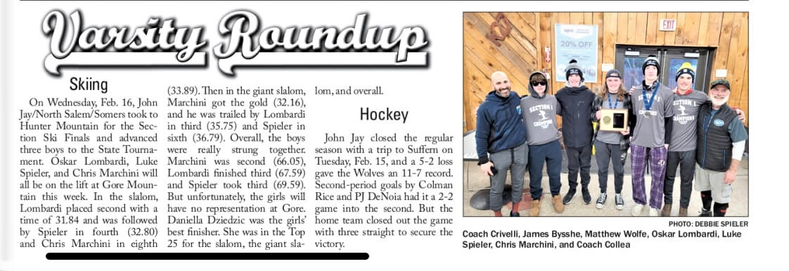
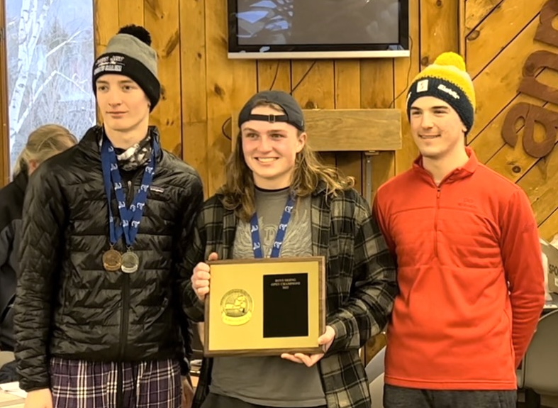
2022 Section 1 Champs
NYSPHSAA Bronze Medal Winners

Slide 5
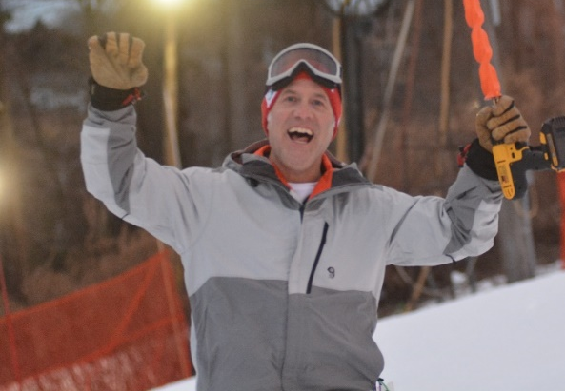
Dan Collea – Men’s Coach
USSA Level 100 Race Coaching Certification
Mount Southington Ski Team Coach
PSIA Certified Ski Instructor
High School Alpine Ski Coach
1990 – 1998: Fallsburg High School
2002 – 2009 / 2017 - present: JJNSSomers
Dan Collea’s contact details:
Email: dcollea@northsalemschools.org
sportsYou: JJNS Ski Team
website: Collea’s Corner

Slide 6
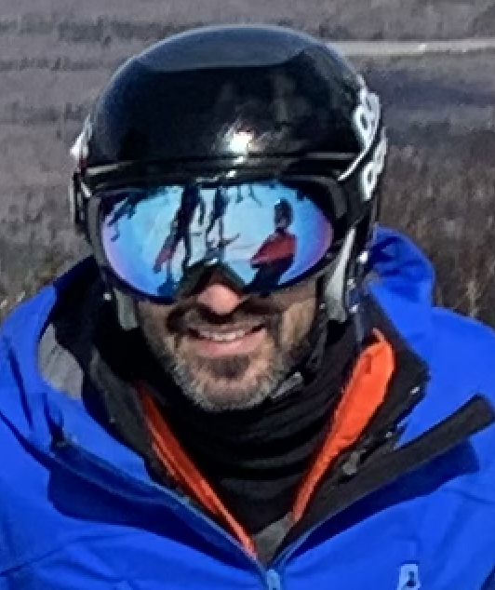
Paul Crivelli - Women's Coach
USSA Level 100 Race Coach
USSA Thunder Ridge Ski Team Coach
High School Alpine Ski Coach
2022 – present: JJNSSomers
Paul Crivelli’s contact details:
email: pcrivelli@klschools.org
sportsYou: JJNS Ski Team
Notes:
Athletes / Parents – Take out your phones – send email to Coach Reinke, and indicate any other emails or parent emails you want to have on the team distribution list.

Slide 7
General Information
Tryouts / Dryland Training will begin Monday, November 27th in the John Jay Fitness Center. Tryouts / Dryland Training will take place every Monday and Wedensday from 3:45 – 5:30pm at John Jay High School. Transportation will be provided to John Jay but athletes will be required to provide their own transportation home.
Team selection will not take place until coaches have seen all athletes ski.
The team may compete at Thunder Ridge, Catamount, Mohawk
and Mount Southington Mountains. Races at Thunder Ridge will
begin the week of 1/8.
The team competes in both Slalom (SL) and Giant Slalom (GS) events.
Notes:
Ted Ligety
Each team is divided into a 10 member “A” team and a “B” team based upon skills and qualifying times .
Somers – May have athletes that will train and race with us, but are not part of our team nor our roster.
“A” squad is a more competitive team who race on more challenging terrain with Boys and Girls on different courses.
“B” squads are considered developmental teams who competes on a combined course on less challenging terrain.
To ensure the safety of the racers, spectators are not allowed up on the hill. A designated “spectator” area is provided by Thunder Ridge near the base area, however all 3 courses may not be easily visible from this location

Slide 8
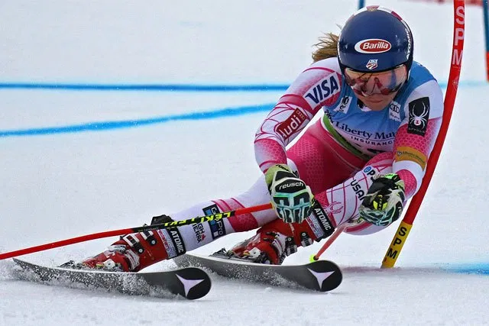
General Information
The team consists of 12 male and 12 female skiers combined
from all three schools.
Most competitions involve 3 or 4 schools competing on a men’s and women’s course.
5 school vs school SL races – Start 2nd week of January
2-3 League SL and GS races - GS races at Catamount or Mohawk
Sectional Championships: TBD (Hunter Mountain)
NYS Championships: 2/25-2/27 (Whiteface Mountain)
Notes:
Mikaela Shiffrin at World Cup – 2016 Killington
The top 5 “A” finishes for each school are combined to represent the schools overall time and ranked to determine the winning team.
Each skier will take 2 runs on their designated course and their best time will be used to determine their overall seeding.
No Section 1 schedule yet – First race of the season could be Tuesday January 7th
Sectionals: Qualifications for top 58 boys and 58 girls from 29 teams in Section 1
Location: (Hunter)
Monday February 10 (2/11 and 2/12 as rain dates)
Race participants determined on Saturday 2/8 (last race of the season is Friday 2/7)
NY State Championships: Top 11 boys and 11 girls from Sectionals
Location: Bristol Mountain
Sunday 2/23 is travel date (MUST ride Section 1 bus to States)
Monday 2/24 SL – Tuesday 2/25 GS races

Slide 9
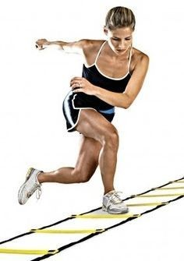
Skills Development / Dryland Training
Participation in all dryland practices is required.
This training will start outdoors and then move indoors.
Physical conditioning is important to reduce injury risk and to ensure all our athletes have a safe experience.
Dryland training will take place at JJHS (3:45-5:30 pm)
and starts Monday, 11/27.
We will try to get on snow
for timed trials ASAP.
Training videos can be found
on The Ski Team page of
Collea’s Corner.
Notes:
On days of land practice at NSHS: Mon & Wed - Ski team bus shall depart JJHS at 3:05 for arrival at NSHS at approximately 3:20.
Conditioning training will conclude at 5:00 and the bus will return to JJHS so the students can catch the 5:30 activity bus.
On days of land practice at JJHS: Tue & Thu– NSHS bus will leave NSHS at 3:00 for arrival at JJHS at approximately 3:20.
JJHS conditioning training will conclude at 5:00 and NSHS will need to be picked up in front of gym.
Each athlete should be ready to begin practice promptly at 3:20 including wearing appropriate clothing for the activities and weather conditions.
No practice the Wed prior to Thanksgiving
JJHS Weight Room – A predetermined circuit has been structured with input from JJHS training staff and required for both teams. The Team will warm-up, run, and stretch outside and then team Captains will lead groups in 25 minutes segments (Cardio, Plyometric and Balance, Strength)

Slide 10
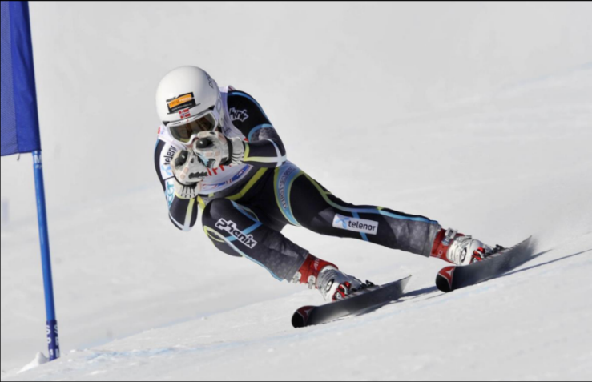
Skills Development / Race Training
Participation in all race training is expected.
Race training is important to develop your skills and reduce the risk of injury.
Race training takes place at Thunder Ridge, Mohawk and Catamount Mountain.
Notes:
On snow practices at Thunder Ridge,
Ski team bus shall depart JJHS at 3:05 and pick up NSHS students at approximately 3:20, before continuing on to Thunder Ridge.
Bring book bags on the bus – schools will be locked when we return
Tentatively the training at the mountain will be for approximately 2 hours, 2 to 3 times a week.
Students will not be permitted to drive directly to Thunder Ridge under any circumstances. Parents will be permitted to take their own child home after competing/practice but a note will be needed to take any other athletes.

Slide 11
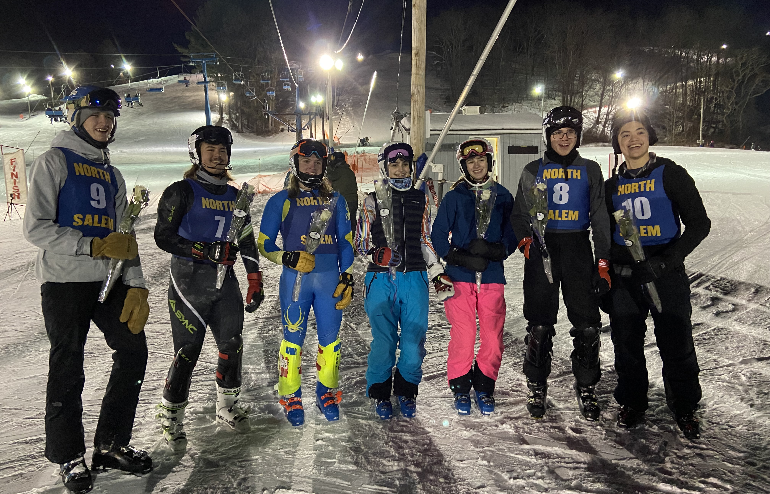
Communication
We will use SportsYou to communicate the MOST UP TO DATE information on schedules, cancellation and race results.
The JJHS, NS, and Somers athletics web sites provides an online calendar where you will find up to date practice, race and cancellation information as well.
Notes:
Lindsey Vonn – Vancouver Olympics 2010
Forms on SportsYou (Mohawk and Catamount Waivers, Conditioning Training, etc)
Per NY State Policy – If any of the schools we are racing against have a snow-day or cancel after school activities then our race has to be postponed. In this situation we will decide to either cancel practice or conduct an on snow practice if JJHS and NSHS are in session.

Slide 12
SportsYou Code

Slide 13
Team Selection
Selection to the team will be based upon the following criteria which will be discussed in detail at the first practice and located on this rubric.
Attitude
Effort
Ability

Slide 14
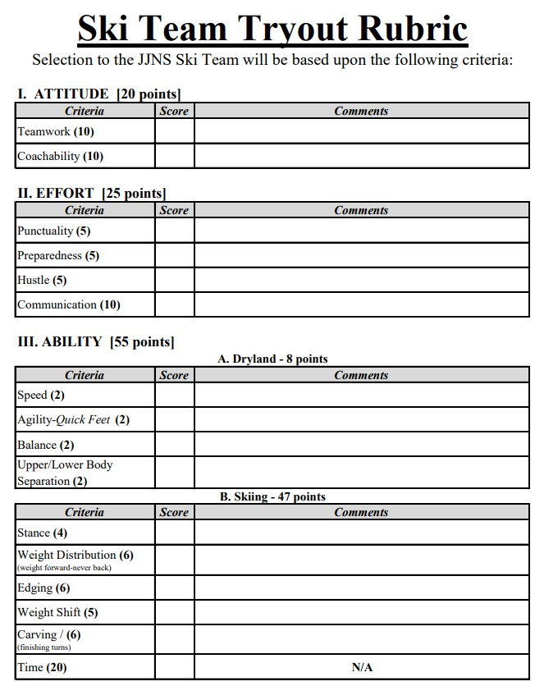
Team Selection

Slide 15
Athletic Policy
Participation at 100% of practices and competitions is expected.
Coaches must be notified in advance of any conflicts
Athletes will be excused from practice following Board of Education guidelines for excused absences.
Employment and outside teams are NOT acceptable absences.
We completely understand, “Life Happens.”
Reconditioning rules may apply for unexcused absences.
Varsity option will be revoked for athletes who have excessive absences from practice or competition.
Notes:
Excused absences include sickness, emergency doctors appointments, funeral, college visit, religious observations. Special exams, any special circumstances that are communicated to the coaches and accepted in advance.
Reconditioning – Any athlete who misses more than 3 consecutive practices/competitions MUST have minimum reconditioning practices before competing:
Miss 5 days – 3 reconditioning practices
Miss 4 days – 2 reconditioning practices
Miss 3 days – 1 reconditioning practice
Consequences for unexcused absences:
1st conflict – 1 game suspension
2nd conflict – additional 2 game suspension
3rd conflict – additional 3 game suspension (that ends our season)
4th conflict – suspension from the team
Concussion Policy – Any suspected or confirmed concussion will require medical clearance prior to participation. We take the possibility of a concussion very seriously and an athlete will be removed from the hill, regardless if doing such impacts their qualification for Sectionals or States – not open for discussion or judgement by athlete or parents.

Slide 16
As a team member I will….
Have fun!
Never give up!
Listen to the coaches.
Always give 100%.
Have fun!
Support teammates.
Respect the Race Officials.
Never brag or make condescending remarks.
Be a positive role model to your teammates.
Always represent the team in a positive manner.
Have fun!

Slide 17
Equipment
Helmets
required ski helmets for all participants at all times they are on the hill
New NYSHSAA requirement for FIS Helmet certification for GS racers. The team has some GS helmets if need be.
Helmet Chin guards (optional)
Slalom skis / GS skis / GS suit (optional)
Mouth guards (optional)
Shin guards / Pole Guards / Arm Guards (optional)
GoPro Cameras – NOT allowed during race
Medication – Important to provide epi pens and inhalers ON THE HILL.
Notes:
Skis: The level of the racer will dictate which type of skis each athlete will need.
- Don’t need dedicated racing equipment (“speed suits” or “race skis”) although we would recommend the equipment be appropriate for the skier’s abilities.
We also strongly recommend that parents have the skier’s equipment checked annually by a certified shop prior to each season.
Most of our racers typically use only one pair of skis, while some of our more advanced racers may have specialized SL and GS skis.
The length of skis is determined by the height, weight and ability of the racer. Coaches are always available to ask for help with ski selection.
Boots:
- Must fit well, as it is the boot that transfers the “message” from the feet to the skis.
Without proper fit, the racer does not have the desired control, and performance will suffer.
Additionally, comfortable boots will promote warmer feet and make for a much more enjoyable experience for the racer.
Helmets: NYS only requires during races, but the coaches require helmets for all participants at all times they are on the hill.
Must fit properly to be of any use; they should fit snugly but not restrictive.
It is not advisable to buy used helmets for your racer,
impossible to determine if a helmet has sustained a significant blow that may compromise its integrity merely by looking at it.
Kids tend to drop helmets on the floor, throw them into the back of vans and cars, and each time the helmet receives a knock it may well be sustaining minor fractures that are not visible on the outside but which reduce the effectiveness of the helmet.
An alpine ski racing helmet that covers the ears is recommended as the preferred style over a recreational style helmet with soft ear protection. Any racers participating in USSA or USASA race programs outside of the school league will be required to have “over the ear” helmets to compete.
FIS requirement for all Speed events
Helmet Chin guards: These guards are attached to the helmet to protect the racer’s face and teeth from being impacted by the breakaway pole. Chin guards are not required, but may be used at the skier’s discretion. Please remember that only a full helmet, one with hard ear covers, can accommodate the chin guard.
Mouth guards: While recommended, are optional and these inexpensive guards used for many sports can help reduce the effects of a concussion should a racer sustain a blow to their head.
Shin guards: once a racer has enough experience and they are ready to start hitting breakaway poles, protective shin guards, arm guards, or pole hand protectors are appropriate.
GoPros: Helmet mounted cameras (GoPro) will not be allowed during competitions, but may be used during practice unless they become a distraction.
Medications: Epi pens and inhalers left in a boot bag in the base lodge will not be effective to treat cold induced asthma or allergic reactions. Please make arrangements to have them on the hill, and provide the coaches with spares to keep in our medical kits (remain in base lodge) if the athletes forgets to bring it to practice they can borrow from the kit and take on the hill.

Slide 18
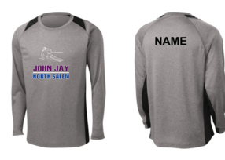
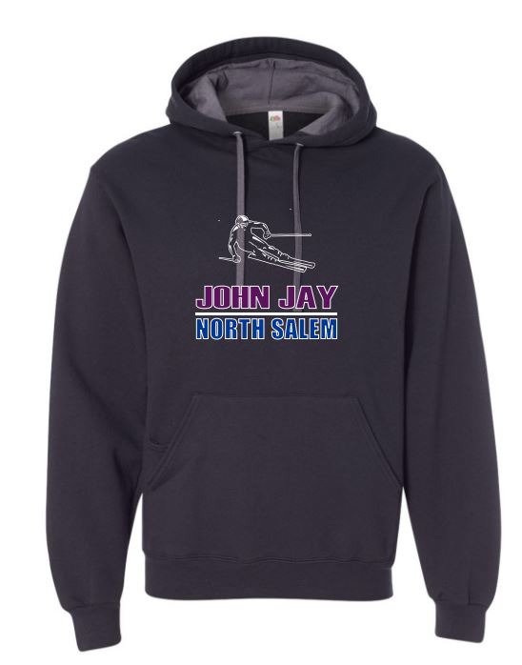
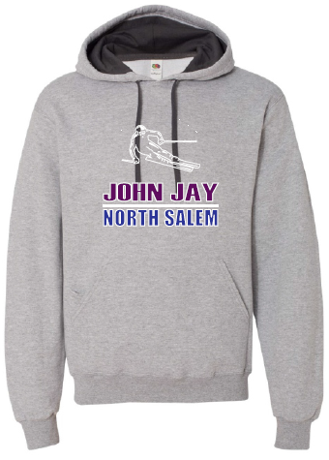
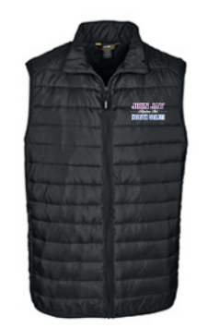
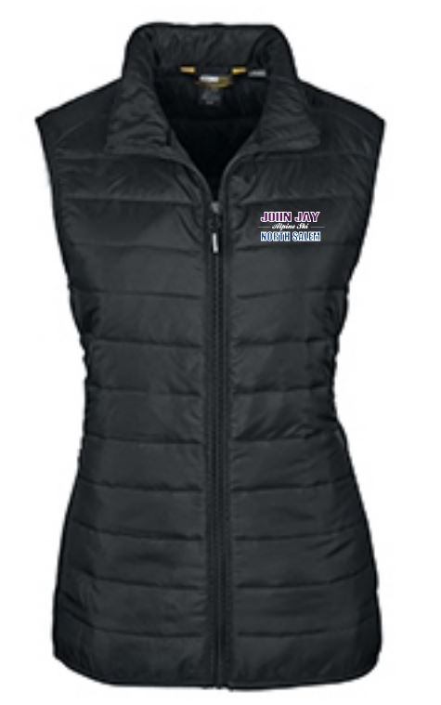
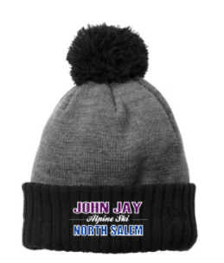
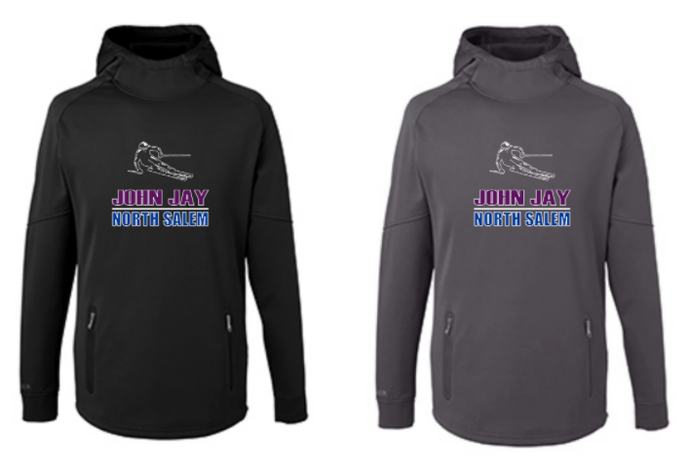
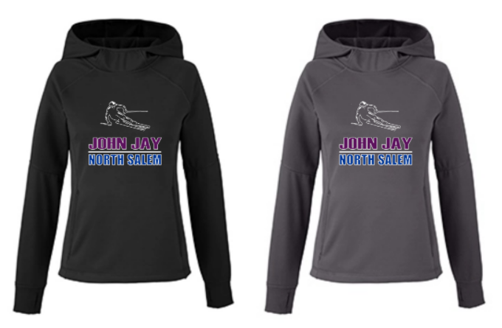
Team Apparel
Purchasing of team apparel is optional and NOT a requirement
All orders will be placed via the dedicated web portal.
Notes:
If we have cuts - 2 order opportunities – December 1st to receive before the season starts, and immediately following our final roster determination (if no cuts then only 1 order)
1st order - Please place your order by 11:59 PM Sunday December 1st
Goods will be delivered within 2 weeks. If there are any stock issues, we will notify you.

Slide 19
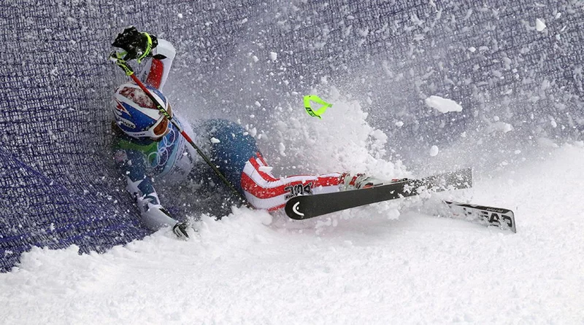
If you ain’t fallin’… …you ain’t tryin’!

Slide 20
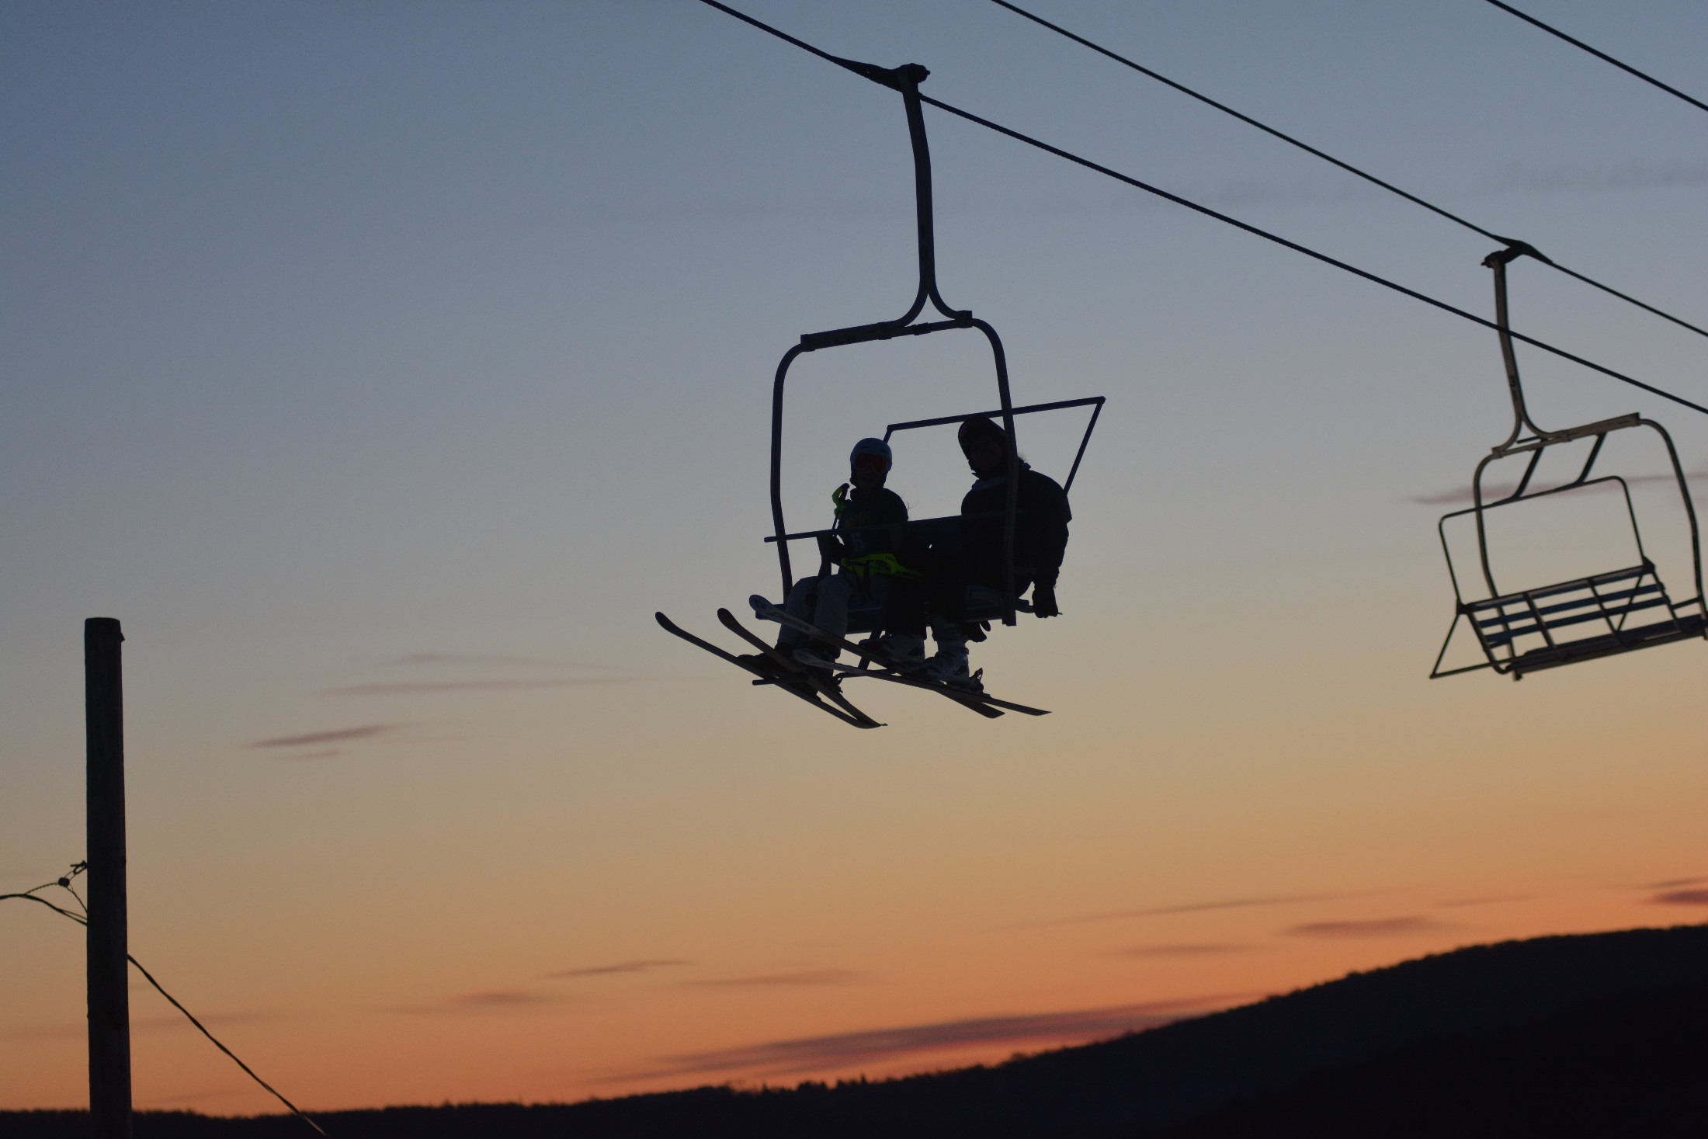
Any Questions?
Feel free to contact Coach Collea or Coach Crivelli anytime!

